Slide 1
06
MACHINE LEARNING WITH SCIKIT-LEARN
Classification
& Ensembles
Open every remaining black box — logistic, trees, SVM — then let committees of models outvote any single one.
Instructor: Shutchon Premchaisawatt
Master's Degree Program · Hands-on with Google Colab

Slide 2
AGENDA
Today's agenda
01
Decision boundaries
what a classifier actually draws
05
Why ensembles
one tree = opinion, many = wisdom
02
Logistic regression
sigmoid, probabilities, weights
06
Bagging → RandomForest
+ feature importances
03
Decision trees
rules you can read aloud
07
Boosting → HistGradientBoosting
and XGBoost beyond
04
Naive Bayes & SVM
the 90-second tour
08
Voting & the full scoreboard
who wins when
Machine Learning with scikit-learn
SESSION 06 · 3

Slide 3
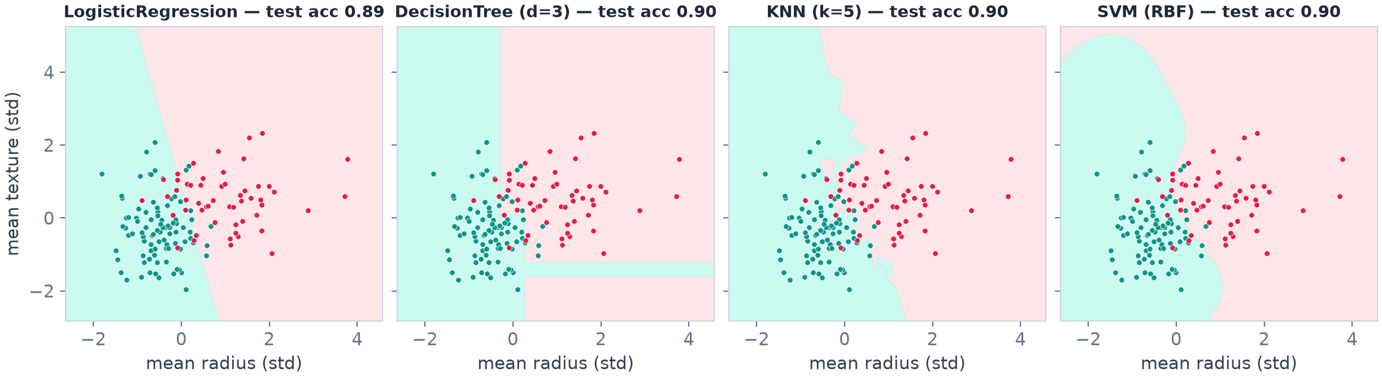
CONCEPT
A classifier draws a boundary
Same data, same goal — different geometry: a straight line (logistic) · axis-aligned rectangles (tree) · wiggly neighborhoods (KNN) · a smooth curve (RBF-SVM)
Real fits on breast cancer (mean radius × mean texture, standardized) — test accuracy printed on each panel
predict() returns the class; predict_proba() returns the probability — every sklearn classifier offers both
Machine Learning with scikit-learn
SESSION 06 · 4

Slide 4
BLACK BOX #2
Logistic regression: a probability pump
z = w·x + b (same as linear!)
sigmoid squashes z into probability 0–1
predict_proba → the number
predict → threshold at 0.5 by default
"Logistic regression" = classification. The name lies.
CV accuracy 0.974 · ROC-AUC 0.995
Machine Learning with scikit-learn
SESSION 06 · 5

Slide 5
INTERPRETATION
Logistic weights = evidence, in log-odds
feature (standardized) | weight | reads as
worst texture | −1.25 | coarser texture → malignant
radius error | −1.07 | size variability → malignant
worst symmetry | −0.96 | asymmetry → malignant
worst concave points | −0.94 | concavities → malignant
area error | −0.94 | area variability → malignant
Same reading skill as S05
linear: weights move the VALUE
logistic: weights move the PROBABILITY
exp(w) = odds ratio — "evidence multiplier"
Trains fast, scales big — the industry default first classifier
(Signs here are data-specific; magnitude = strength of evidence. Positive class = benign in this encoding.)
Machine Learning with scikit-learn
SESSION 06 · 6

Slide 6
BLACK BOX #3
Decision trees: 20 questions for tumors
"worst radius ≤ 16.8?"
no → malignant-ish branch
→
"concave points ≤ 0.14?"
yes → likely benign
→
"area error ≤ 91.6?"
refine again
→
leaf
predict class + proba
How is a question chosen?
try candidate thresholds per feature
keep the split that best separates the classes (Gini / entropy — purity math, intuition is enough)
Stop when: max_depth / min_samples_leaf / pure leaves
No scaling needed — thresholds compare raw values
Machine Learning with scikit-learn
SESSION 06 · 7

Slide 7
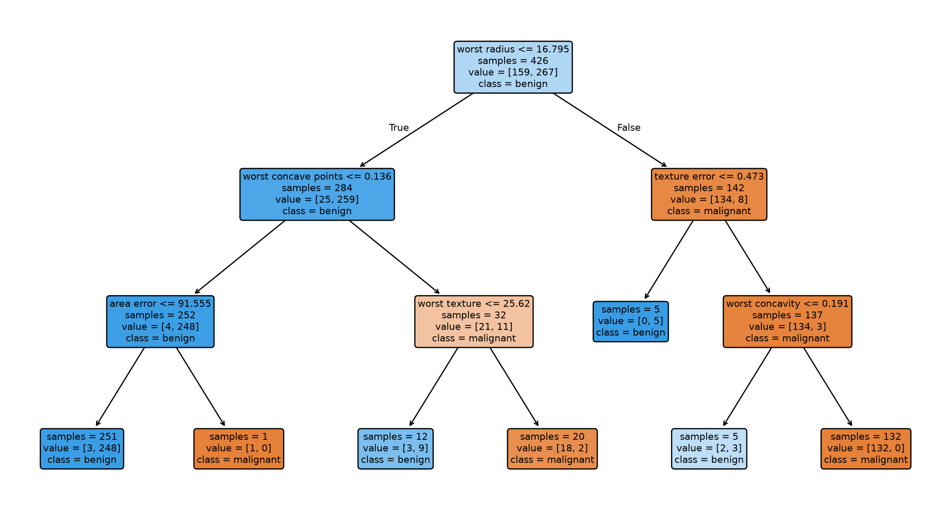
INTERPRETATION
A real fitted tree, read aloud
This IS the model
export_text(tree, feature_names=…)
a doctor can audit every decision
"Small, smooth tumors are benign" — the data says so
  plot_tree() draws it as a flowchart
plot_tree(tree3) — the same depth-3 model, drawn as a flowchart (test acc 0.944)
Machine Learning with scikit-learn
SESSION 06 · 8

Slide 8
TREES' DARK SIDE
Unleashed, a tree memorizes everything
tree | train acc | CV acc | AUC
unrestricted | 1.000 | 0.910 | 0.900
max_depth = 3 | 0.977 | 0.924 | 0.934
Also: trees are unstable
Two random samples → two quite different trees.
High variance is the disease.
Ensembles are the cure.
Remember this slide — the next one pays it off.
A free tree grows until every leaf is pure
one patient per leaf → 100% train accuracy
its CV accuracy (0.910) is the WORST of today's models
restrict depth / min_samples → generalizes better
…or grow many restricted trees and average them → RandomForest (soon)
Machine Learning with scikit-learn
SESSION 06 · 9

Slide 9
THE 90-SECOND TOUR
Naive Bayes & SVM
GaussianNB — 0.930 acc / 0.986 AUC
Assumes features are independent given the class (naive — they never are).
And still works shockingly well.
· trains in a blink, tiny data OK
· THE classic for spam & text (S06 of any NLP course)
Use when: speed, small data, or a strong baseline.
SVM (RBF) — 0.977 acc / 0.995 AUC ★ today's best single
Draws the widest street between classes (max margin), possibly curved via kernels.
· powerful on small/medium clean data
· NEEDS scaling (S03!)
· doesn't scale to millions of rows; no predict_proba by default
Use when: medium data, strong boundaries.
Machine Learning with scikit-learn
SESSION 06 · 10

Slide 10
SCOREBOARD 1/2
Single models, stratified 5-fold CV
model | CV acc | AUC
Dummy (most_frequent) | 0.627 | 0.500
DecisionTree (free) | 0.910 | 0.900
GaussianNB | 0.930 | 0.986
KNN (k=5) | 0.963 | 0.985
LogisticRegression | 0.974 | 0.995
SVM (RBF) | 0.977 | 0.995
Next question
Can we COMBINE models —
take a few imperfect opinions
and beat the best single one?
(The answer is yes —
and it's how real tabular ML
competitions are won.)
Every model beats Dummy by miles — but AUC (0.900 vs 0.995) separates them far better than accuracy, and ranks the free tree LAST
Machine Learning with scikit-learn
SESSION 06 · 11

Slide 11
★ ENSEMBLES
Wisdom of crowds: why committees work
One tree: high variance
new sample → new tree → new opinions
Ask 100 slightly-different trees
each sees a random slice of rows & features
errors are UNCORRELATED-ish → they cancel in the vote
Conditions (the ML version of Galton's ox):
  each member better than chance
  members disagree with each other
  aggregate by voting (classify) or averaging (regress)
tree 1
(random slice)
→
tree 2
(random slice)
VOTE /
average
→
tree 3
(random slice)
→
… × 100
Machine Learning with scikit-learn
SESSION 06 · 12

Slide 12
★ ENSEMBLES
RandomForest: bagging + a random twist
bootstrap rows
sample WITH replacement
→
random features per split
the "forest" twist
→
grow deep tree
no pruning — variance is fine
→
× 100 trees → vote
aggregate
model | CV acc | AUC
single free tree | 0.910 | 0.900
RandomForest(100) | 0.956 | 0.989
Why it works
Deep trees = low bias, high variance.
Averaging 100 uncorrelated-ish trees ≈ variance ÷ 100.
Strong default: little tuning, no scaling needed, handles mixed types.
Feature importances (real, this dataset)
worst area 0.15 · concave points 0.13 · mean concave 0.11
≈ "which columns did the forest actually use?"
Caveat: correlated features share/split credit — read as a hint, not a verdict
Machine Learning with scikit-learn
SESSION 06 · 13

Slide 13
★ ENSEMBLES
Boosting: each tree fixes the last one's mistakes
tree 1
predicts; notes its misses
→
tree 2
focuses on tree 1's misses
→
tree 3…N
keeps chasing residuals
→
sum of all
shallow but cumulative
model | CV acc | AUC
RandomForest(100) | 0.956 | 0.989
HistGradientBoosting | 0.967 | 0.992
Bagging: parallel, deep trees, vote · Boosting: sequential, shallow trees, add up — HistGB is sklearn's fast boosting (native NaN support!)
Same family beyond sklearn: XGBoost, LightGBM, CatBoost — the kings of tabular Kaggle. Your S08 project can try them.
Machine Learning with scikit-learn
SESSION 06 · 14

Slide 14
★ ENSEMBLES
Voting & stacking: mix different species
vote = VotingClassifier([
("lr", make_pipeline(StandardScaler(),
LogisticRegression(max_iter=5000))),
("rf", RandomForestClassifier(random_state=42)),
("knn", make_pipeline(StandardScaler(),
KNeighborsClassifier()))],
voting="soft") # average PROBABILITIES
hard voting
each model votes a class label
soft voting (better)
average predict_proba — confidence counts
  Stacking: a small "meta-model" learns to weight the members — sklearn's StackingClassifier
Members should DISAGREE (diversity > quantity)
model | CV acc | AUC
Voting(LR + RF + KNN) | 0.972 | 0.995
Machine Learning with scikit-learn
SESSION 06 · 15

Slide 15
SCOREBOARD 2/2
The full table — and its three lessons
model | CV acc | AUC
Dummy (most_frequent) | 0.627 | 0.500
DecisionTree (free) | 0.910 | 0.900
GaussianNB | 0.930 | 0.986
RandomForest(100) | 0.956 | 0.989
KNN (k=5) | 0.963 | 0.985
HistGradientBoosting | 0.967 | 0.992
Voting(LR+RF+KNN) | 0.972 | 0.995
LogisticRegression | 0.974 | 0.995
SVM (RBF) | 0.977 | 0.995
Lesson 1
ensembles lifted the tree 0.910 → 0.956+
Lesson 2
on this easy set, tuned singles match ensembles —
no free lunch; ALWAYS run the table (S04 method)
Lesson 3
on bigger, messier tabular data, boosting usually wins
(that's why S08 lets you try XGBoost)
Machine Learning with scikit-learn
SESSION 06 · 16

Slide 16
GUIDE
Which classifier when?
situation | start with | strength | watch out
Baseline / speed / text | GaussianNB | instant | independence lie
Explanation: audit trail | Logistic / small tree | readable | linear-ish
Small-medium, clean | SVM (RBF) | top accuracy | scaling + scale-up
Tabular default | RandomForest | robust, no scaling | big memory
Max tabular accuracy | HistGB / XGBoost | Kaggle kings | tuning (S07)
squeeze out the last % | Voting / Stacking | diversity pays | complexity
And remember: the winner varies per dataset — the S04 comparison protocol is the real skill.
Machine Learning with scikit-learn
SESSION 06 · 17

Slide 17
LAB 06 · DO IT IN GOOGLE COLAB
ประกวดโมเดลจัดหมวดมะเร็งเต้านม — รวมถึง ensembles
YOUR MISSION (โจทย์ภาษาไทยใน Colab)
Learning goal
Run today's full zoo on breast cancer with stratified CV, read real trees and importances, and prove the ensemble effect yourself.
เทียบ Dummy / LogisticRegression / GaussianNB / SVM / KNN / DecisionTree ด้วย StratifiedKFold (acc + ROC-AUC)
โชว์กฎของ DecisionTree(max_depth=3) ด้วย export_text แล้วอ่านออกเสียงเป็นประโยคไทย
พิสูจน์ ensemble effect: tree เดี่ยว vs RandomForest vs HistGradientBoosting
ดู feature_importances_ ของ RandomForest — ฟีเจอร์ไหนสำคัญที่สุด ตรงกับความรู้ทางการแพทย์ไหม
โจทย์ชวนคิด: สร้าง VotingClassifier ของตัวเอง (เลือกสมาชิกให้หลากหลาย) แล้วดูว่าชนะสมาชิกตัวไหนไหม
Vibe coding corner
ลองถาม AI: “อธิบายความต่างระหว่าง bagging กับ boosting เหมือนสอนเด็ก 12 ขวบ” แล้วเขียนคำอธิบาย 3 บรรทัดเป็นภาษาไทยใน markdown cell — เช็กว่าตรงกับสไลด์ไหม
Machine Learning with scikit-learn
SESSION 06 · 18

Slide 18
KEY TAKEAWAYS
1. Classifiers differ in the boundaries they draw: lines (logistic/SVM), rectangles (trees), neighborhoods (KNN).
2. Logistic turns evidence into probability; small trees turn it into rules you can audit.
3. A free tree memorizes (CV 0.910, worst of the day) — restriction or aggregation fixes it.
4. Bagging averages deep trees (RandomForest 0.956); boosting chains shallow ones (HistGB 0.967); voting mixes species (0.972).
5. No universal winner — the S04 protocol (same folds, right metric, Dummy anchor) is the real skill.
NEXT
Session 07 — Unsupervised Learning + Hyperparameter Tuning — structure, and squeezing
Machine Learning with scikit-learn
SESSION 06 · 19

